Slide 1
Quick Intro to SGD, Momentum and RMSProp Optimisation

Slide 2
We are going to learn about neural networks
But a NN is simply a structured graph
to solve a problem
We need an “optimiser” to
do the actual work
We will learn about 3 optimisers

Slide 3
SGD optimisation (graphical demo)

Slide 4
Typical gradient descent optimisation (graphical demo)

Slide 5
A lot of oscillating and steps needed.
The oscillations slow down the learning process in gradient descent.
We can’t have a large learning rate incase we overshoot

Slide 6
Intuition behind Momentum (graphical demo)

Slide 7
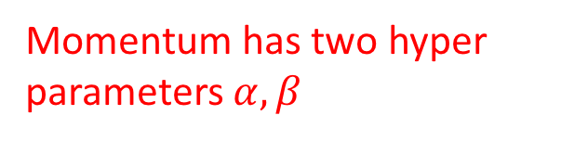
Momentum Optimisation
Momentum has two hyper parameters $α, β$
Let’s do this in Excel

Slide 8
RMSProp Intuition – Speed up Search
(graphical demo)

Slide 10
Each weight will be optimised individually so that the large oscillations are reduced. Consequently we can have a large learning rate to speed up learning
Let’s do this in Excel

